Slide 1
Welcome to CS4141 PSLG!
With Robert and Jakub

Slide 2

Java method
A reusable block of code that performs specific operation/task​
Syntax:​
<access modifier>static<return type><name>(<parameters>)​
Access modifier: public/private.​
Return type: the data type returned by the method.​
“void” if the method is a procedure​
Parameters: data supplied by you to the method.​
Examples:​
private static int square(int a){​
return a*a;​
}​

Slide 3
Problem
Write a Java method named printHello that prints "Hello, World!“ to the console.

Slide 4
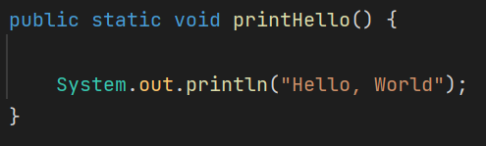
Answer:

Slide 5
Problem
Write a Java method sum that takes two parameters and returns their sum.
Write a Java method square that takes one parameter and returns the number squared.

Slide 6
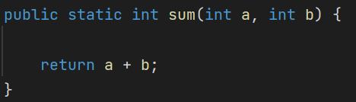
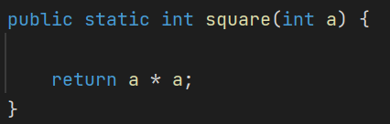
Answer:

Slide 7
Problem
Write a Java method power that takes two parameters and returns the result of raising one to the power of the other.

Slide 8
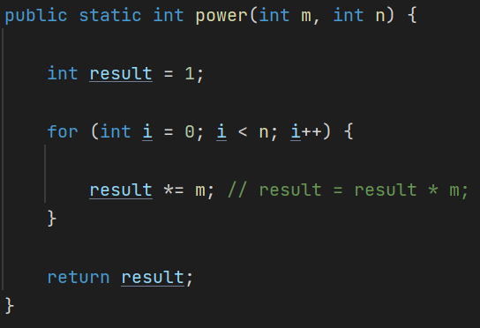
Answer:

Slide 9
Problem
Write a Java method called max that takes two numbers as parameters and returns the larger one.

Slide 10
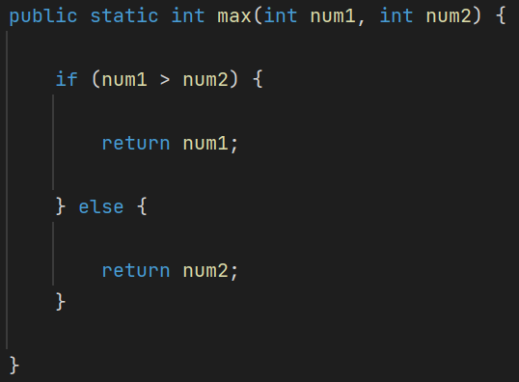
Answer:

Slide 11
Thank you for coming!

